Slide 1
机器人: 基本原理
Prof. Mark Yim University of Pennsylvania
第六周:逆向运动学
Robo1x-1.5

Slide 2
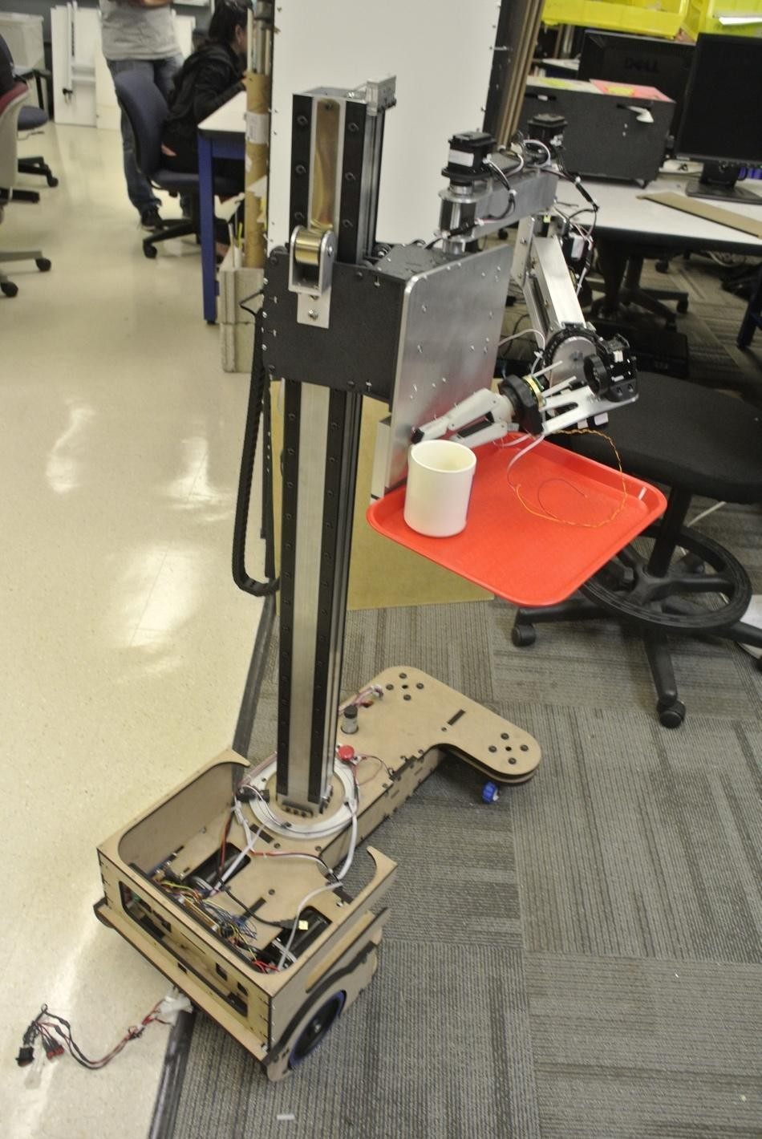
逆向运动学
Robo1x-1.5

Slide 3
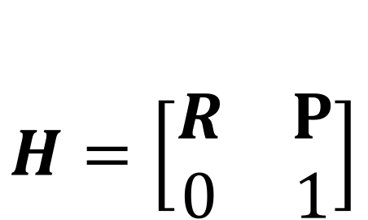

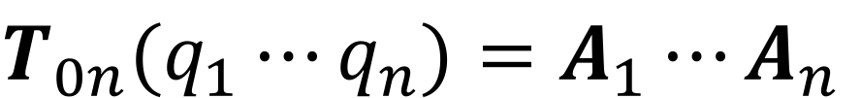
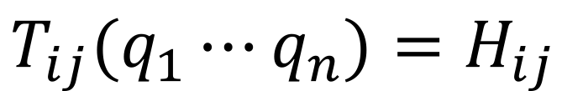
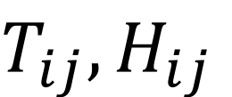
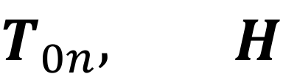
逆运动学的定义
Where,
refer to the 12 nontrivial
entries of
and
Robo1x-1.5

Slide 4
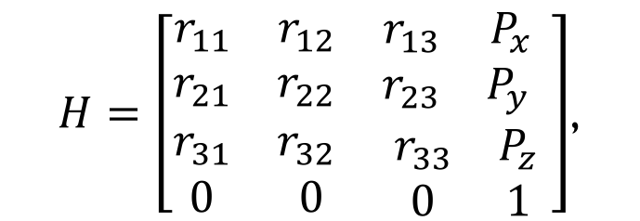
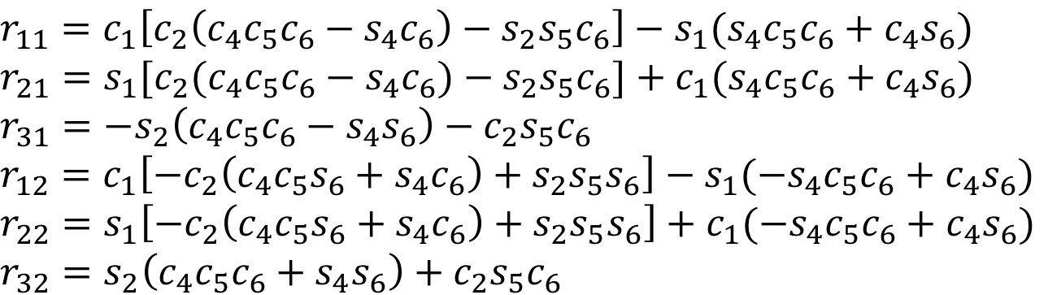
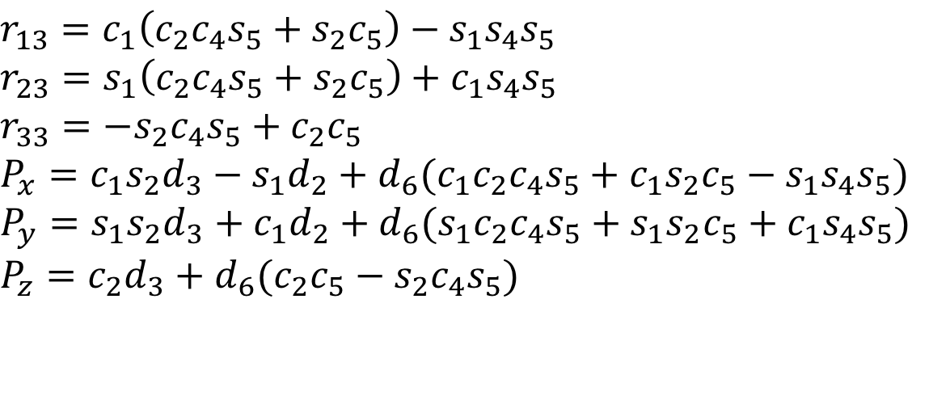
斯坦福机械臂的转换
12 非线性方程式, 7 未知数
Robo1x-1.5 4

Slide 5
方法
封闭的形式：
几何方法
IKFast (开源C++代码)近似解决方案
Lterative 优化
Jacobian 逆
Robo1x-1.5

Slide 6
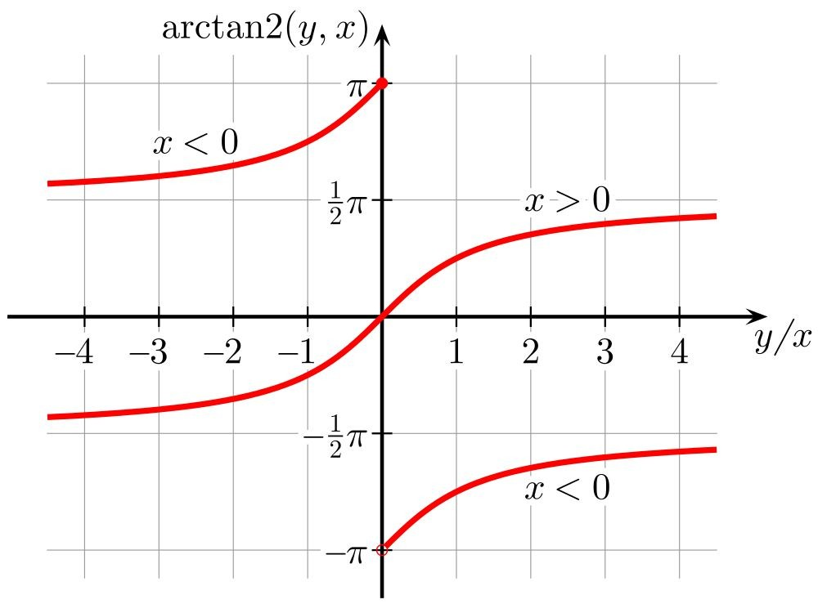
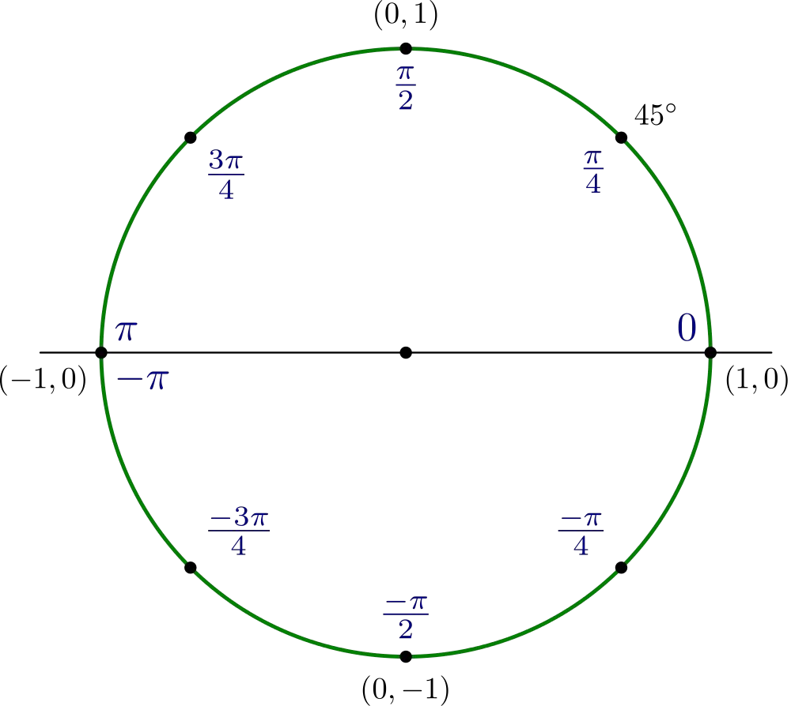
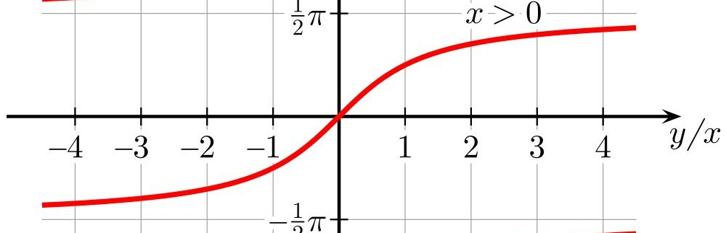
atan(y/x) vs atan2(y,x)
atan(y/x)
By Qef (self-made using design of the bitmap version) [CC0]
By Geek3 (Own work) [GFDL]
Robo1x-1.5

Slide 7
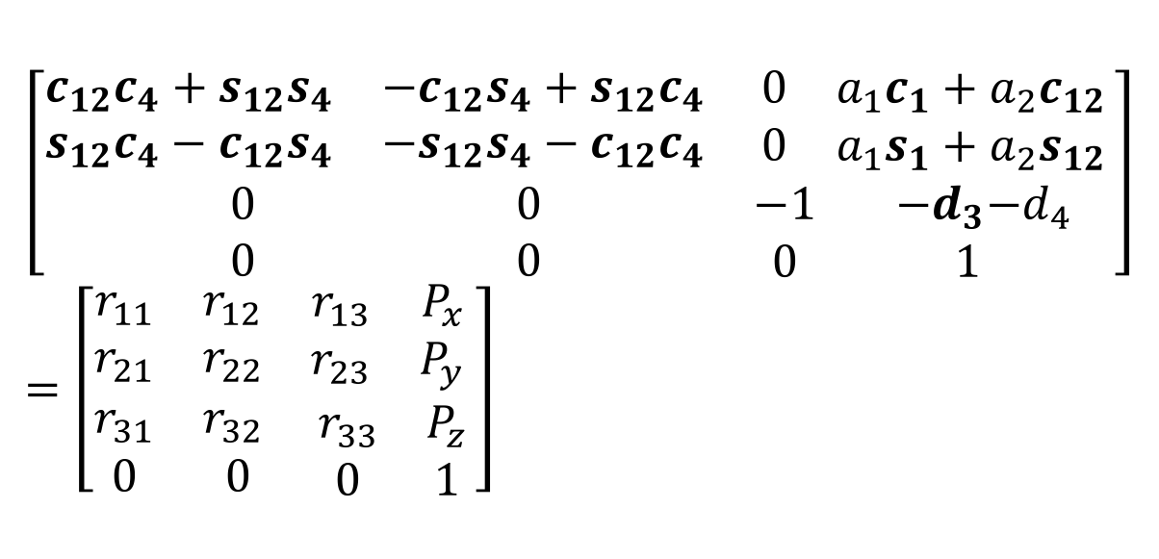
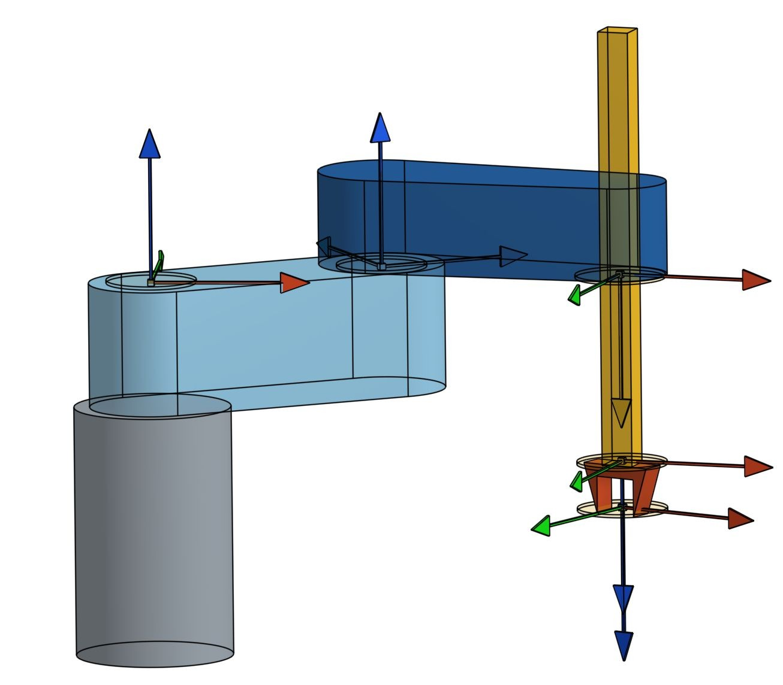
SCARA IK
Robo1x-1.5
θ₂
θ₁
d₃
θ₄
7

Slide 8
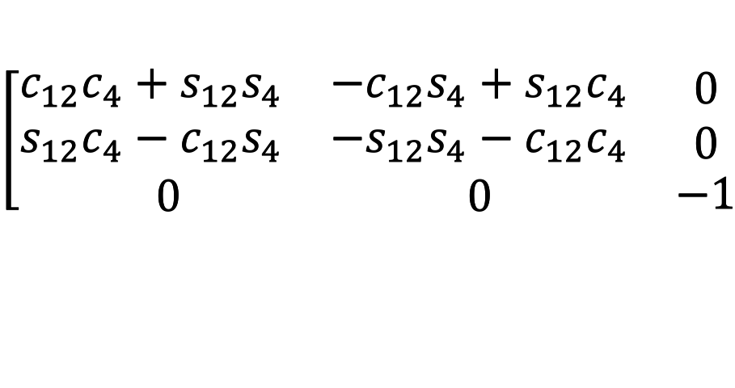
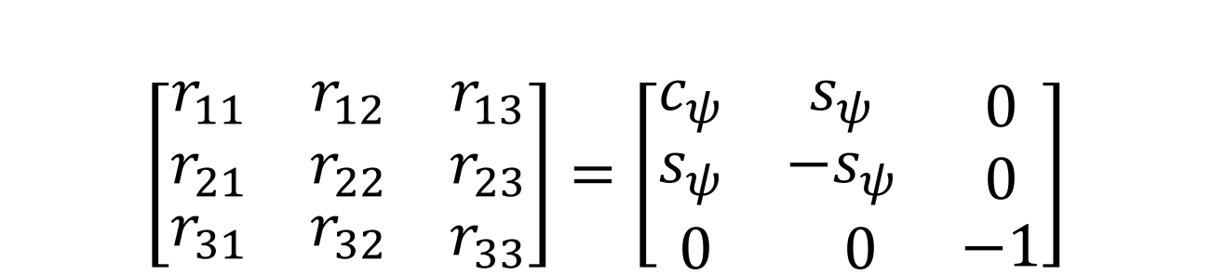
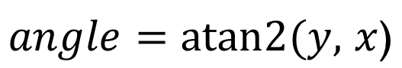
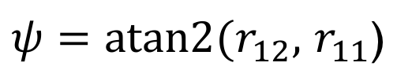
SCARA IK
Robo1x-1.5 8

Slide 9
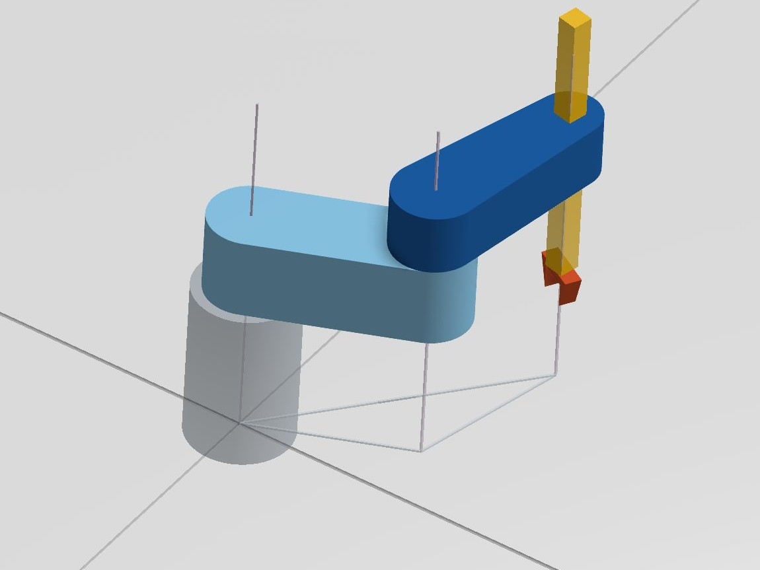
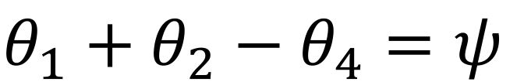
SCARA IK
Robo1x-1.5 9

Slide 10
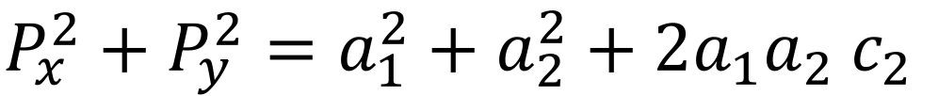
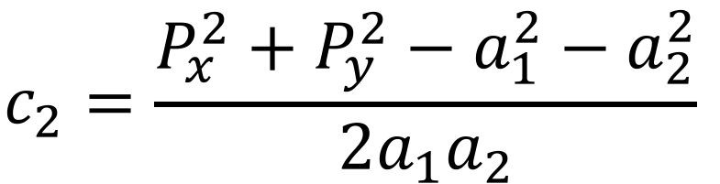
SCARA IK
Robo1x-1.5 10
(P_{x}, P_{y})
a₂
a
1
θ₂
θ₁

Slide 11

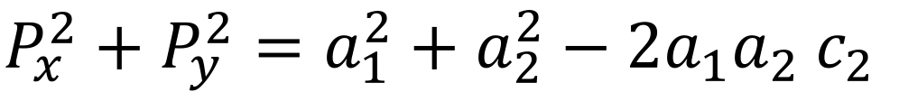
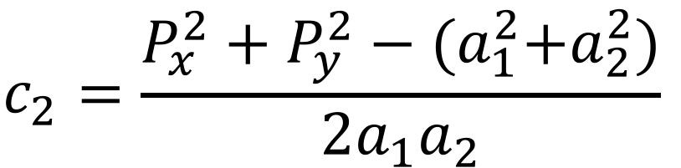
(P_{x}, P_{y})
a₂
a
1
θ₂
θ₁
Robo1x-1.5

Slide 12
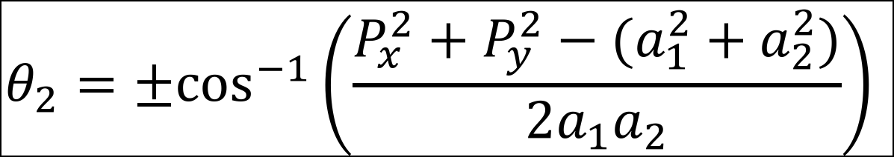

(P_{x}, P_{y})
a₂
a
1
θ₂
θ₁
Robo1x-1.5

Slide 13

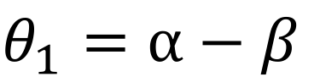
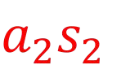
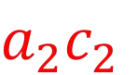
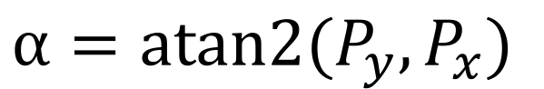
Robo1x-1.5 13
(P_{x}, P_{y})
β
a₂
a₁
α
θ
θ
2
1

Slide 14
(P_{x}, P_{y})
β
a₂
a₁
α
θ
θ
2
1
Robo1x-1.5 14

Slide 15
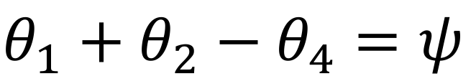
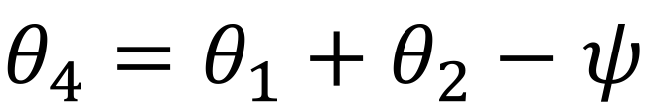
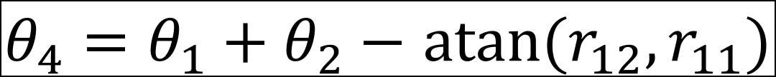
SCARA IK
Robo1x-1.5 15

Slide 16
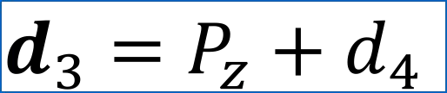
SCARA IK d₃
d₃
d₄
P
Robo1x-1.5

Slide 17
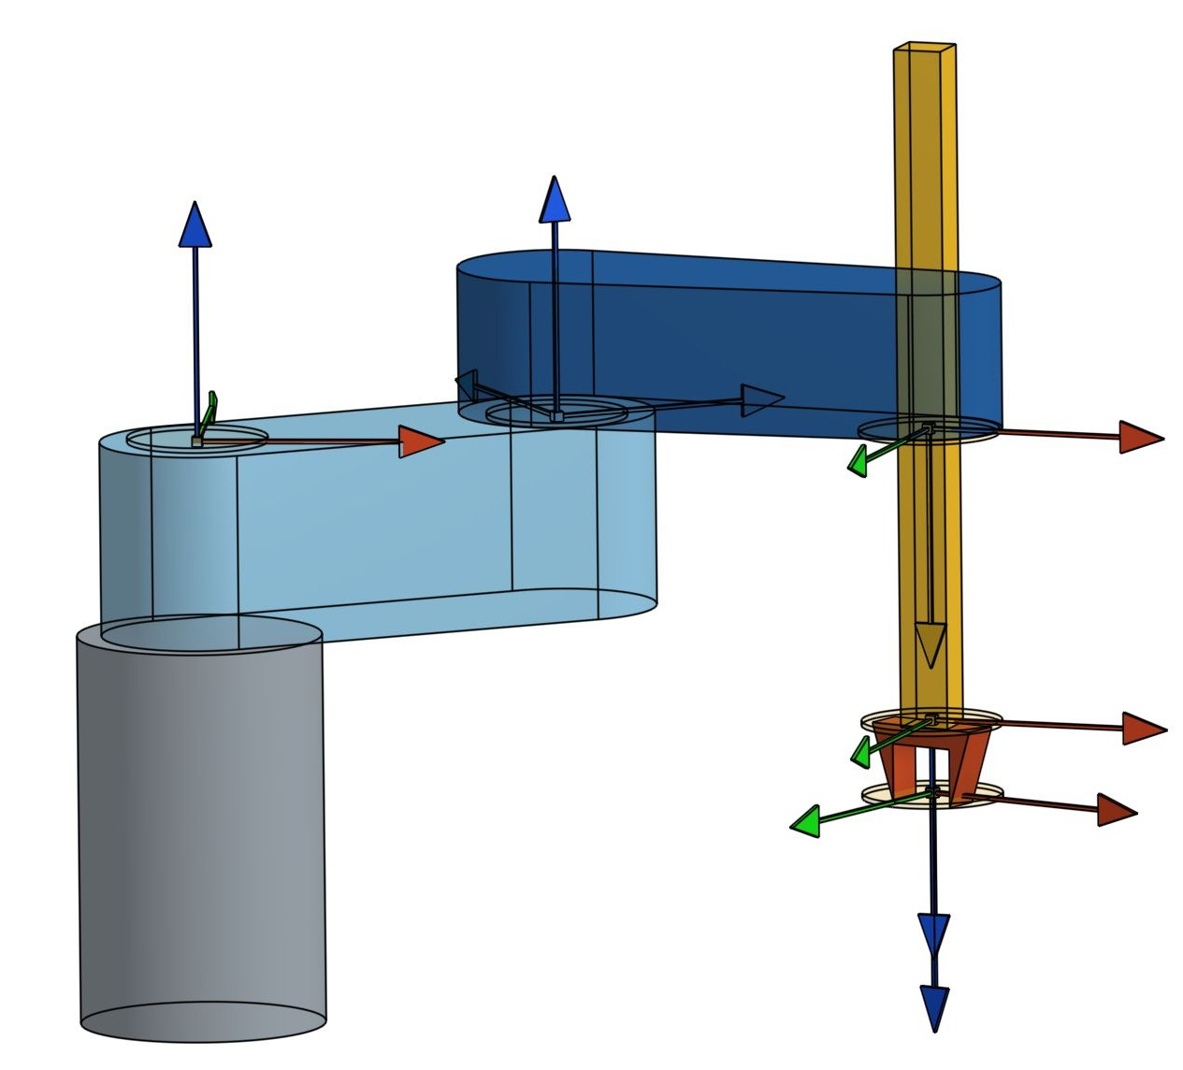
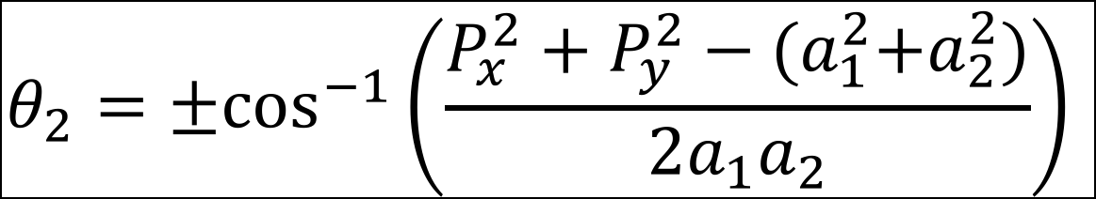
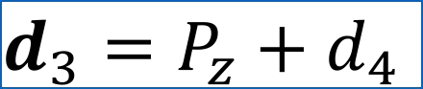
SCARA IK
Robo1x-1.5

Slide 18
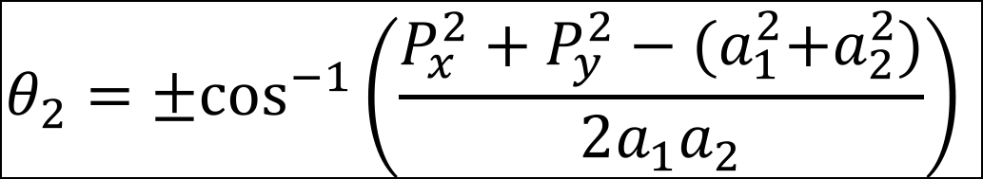
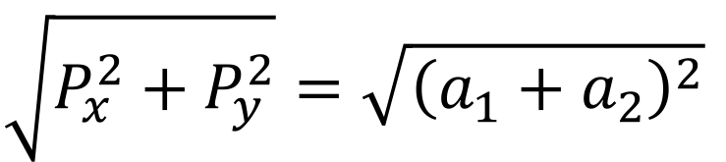
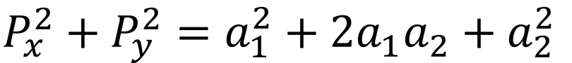
SCARA IK
Robo1x-1.5

Slide 19
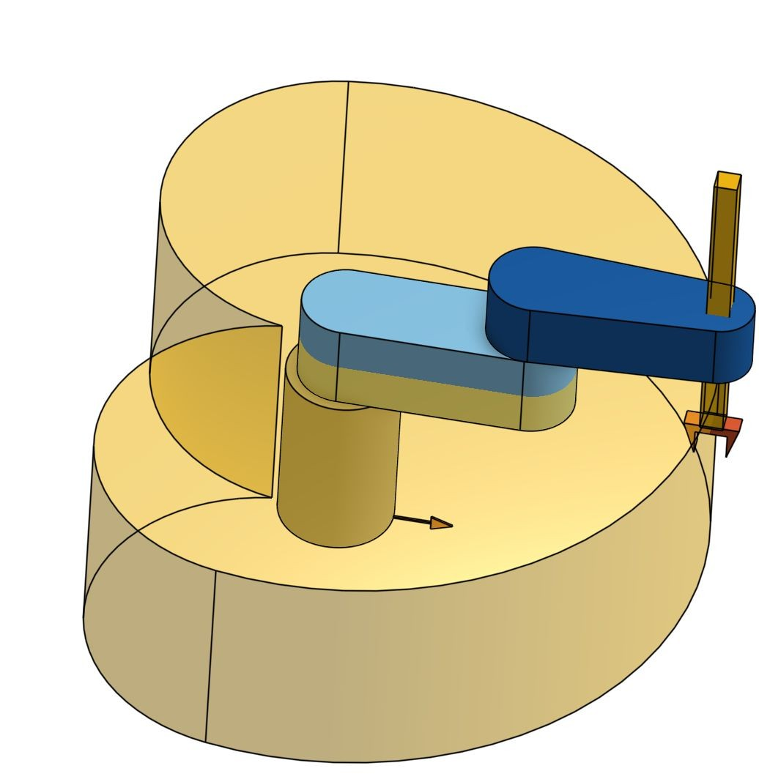
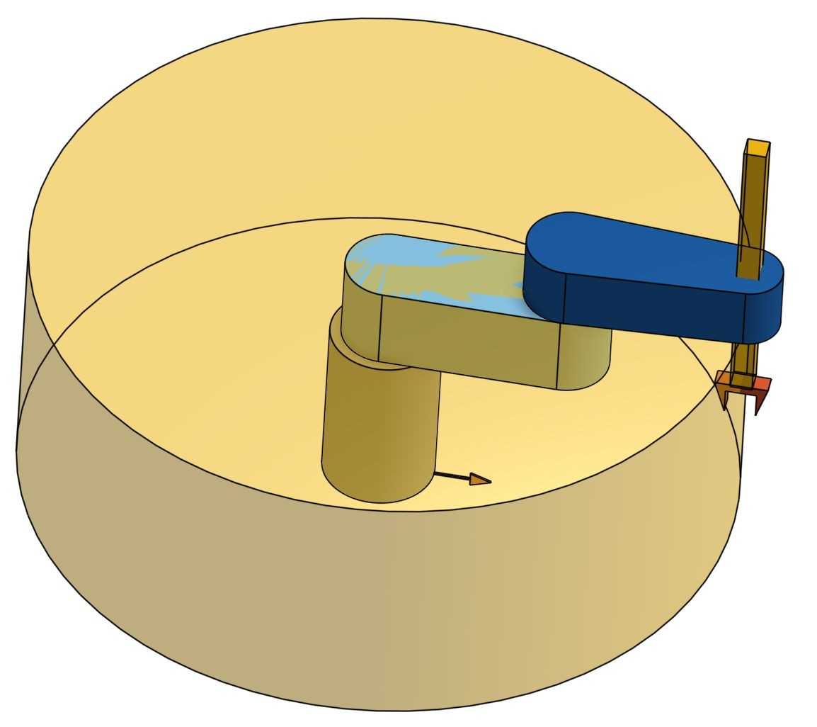
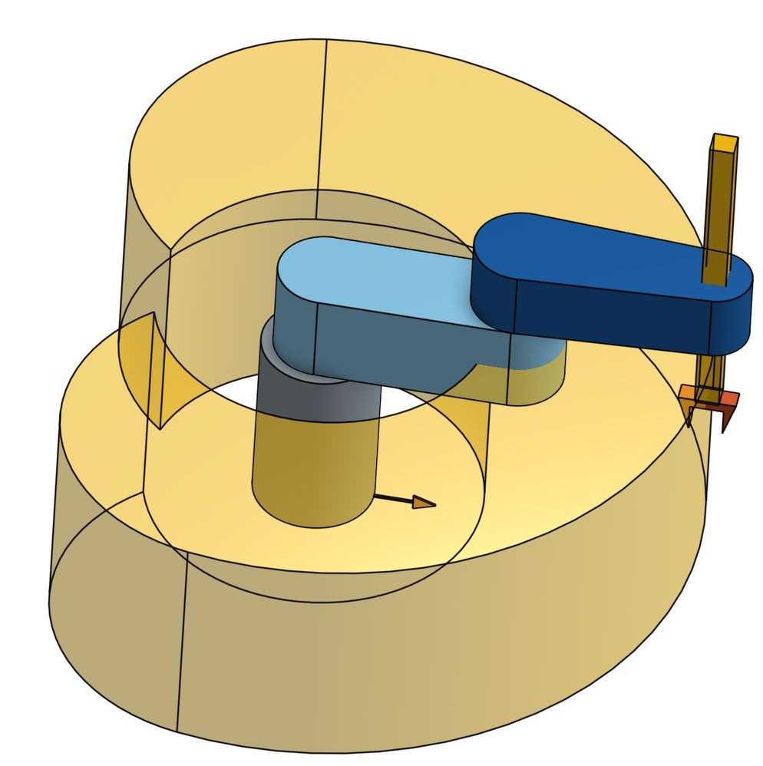
Workspace
bo
Ro
1x-1.5

Slide 20
Robotics: Fundamentals
Prof. Mark Yim University of Pennsylvania
Week 6: Kinematic Decoupling and Inverse Position
Robo1x-1.5

Slide 21
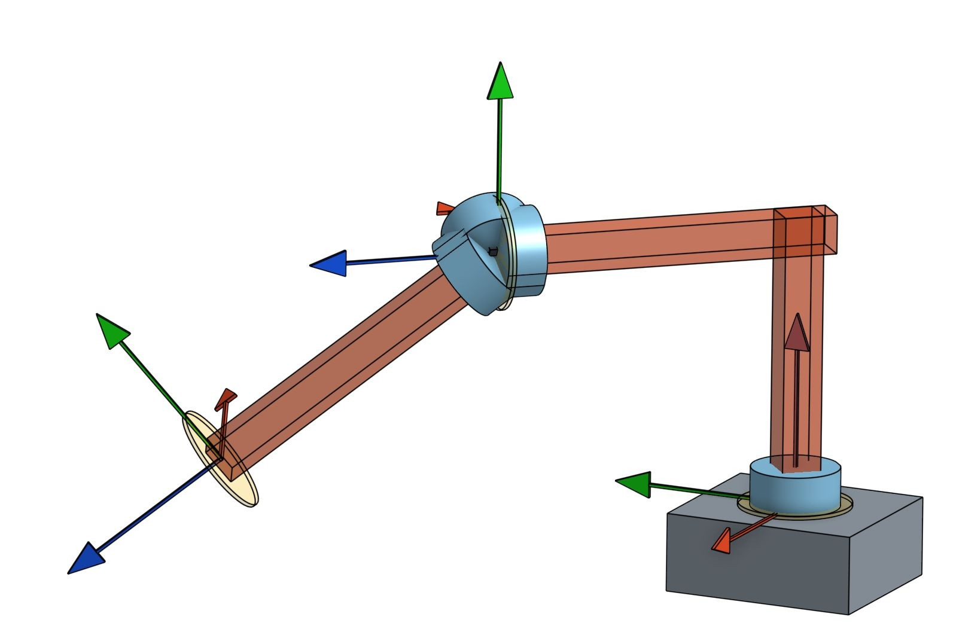
Kinematic Decoupling
Robo1x-1.5

Slide 22
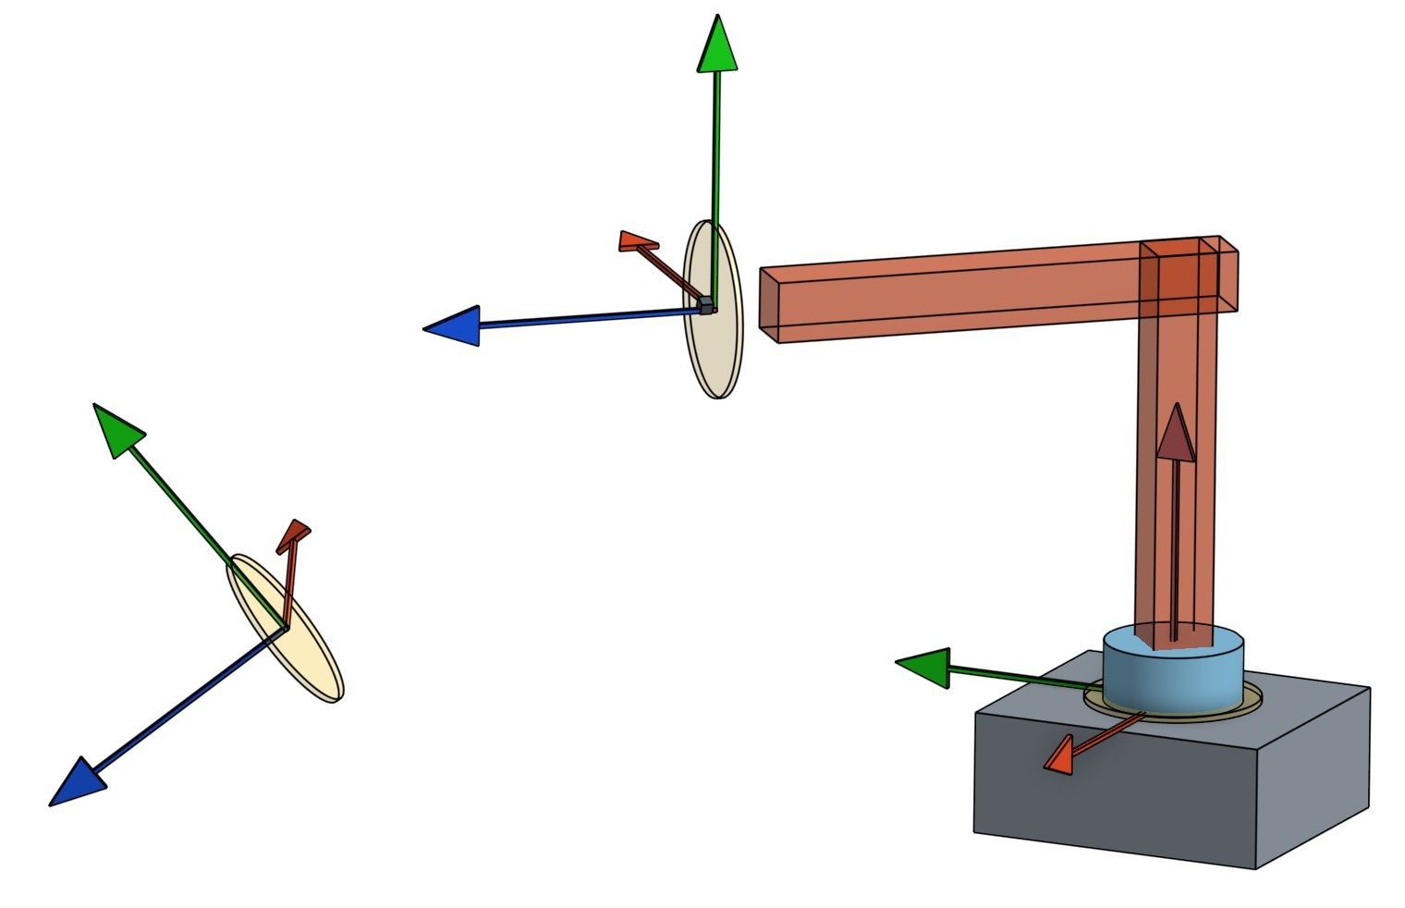
Kinematic Decoupling
Robo1x-1.5

Slide 23
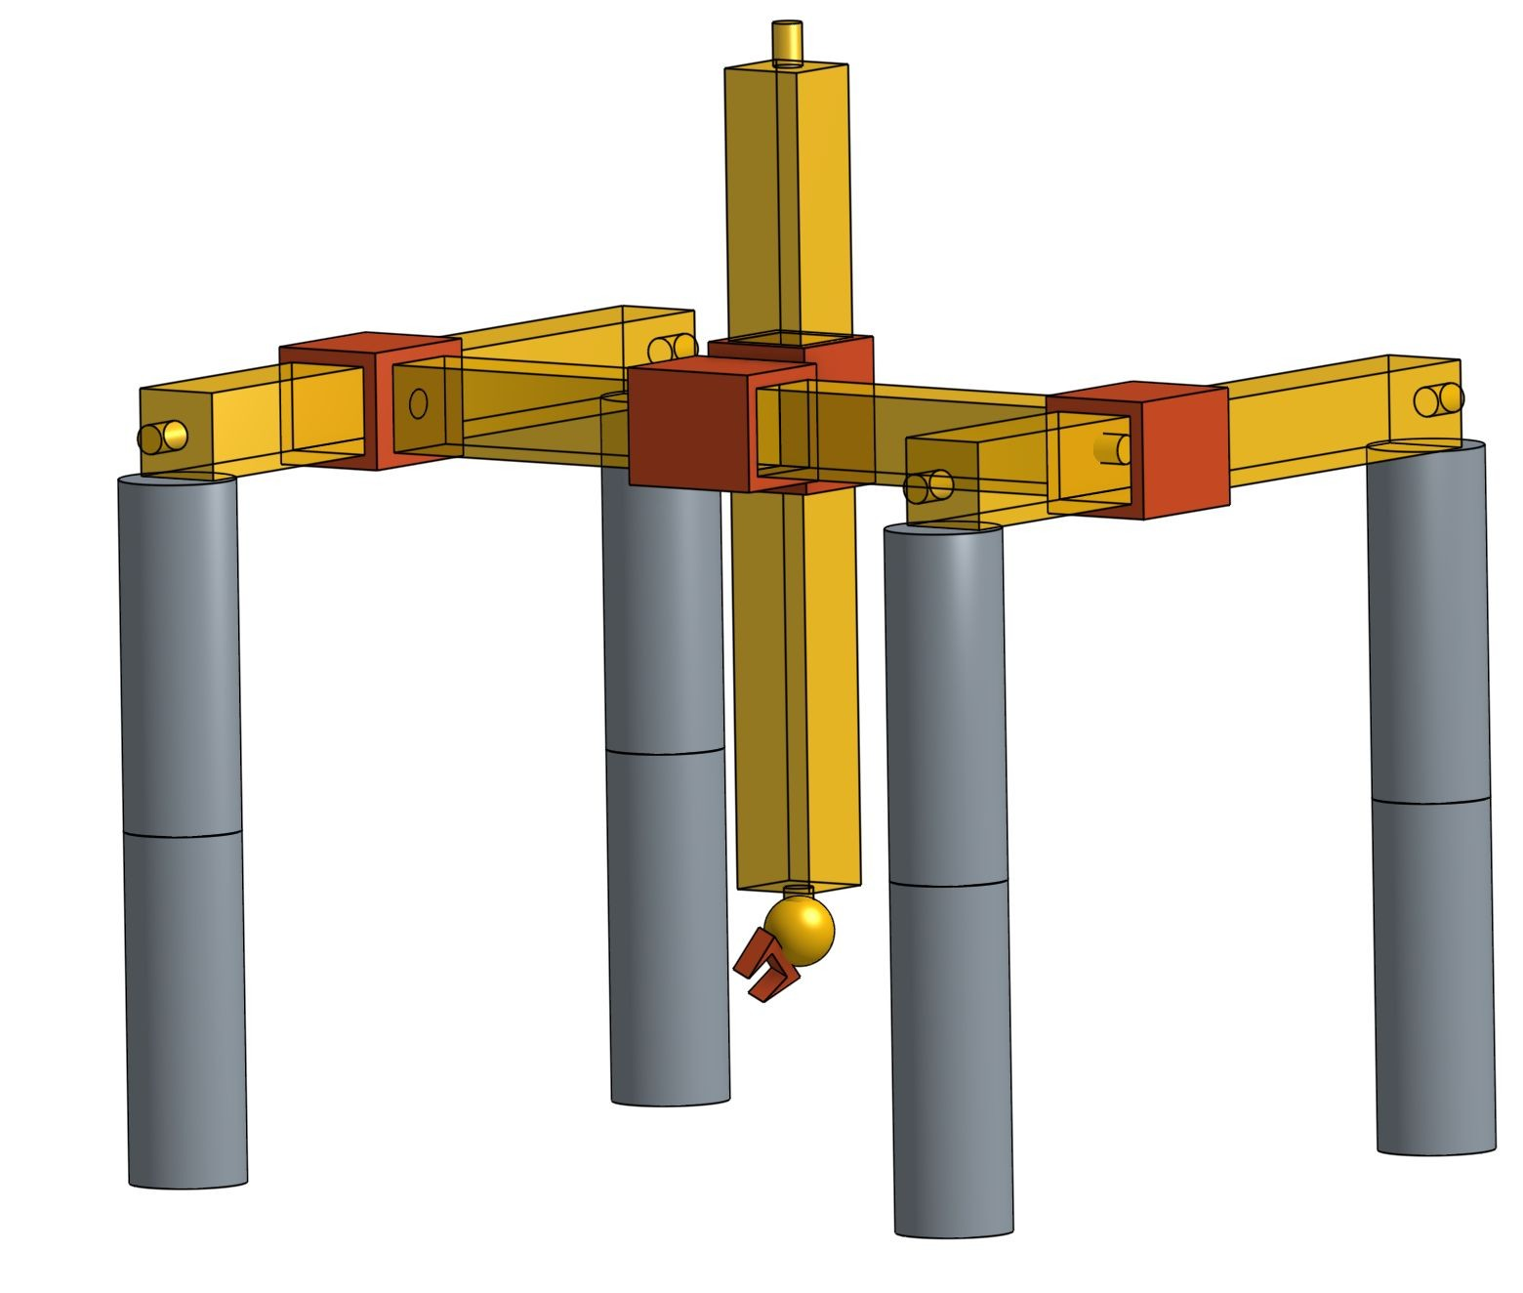
Kinematic Decoupling
Robo1x-1.5

Slide 24
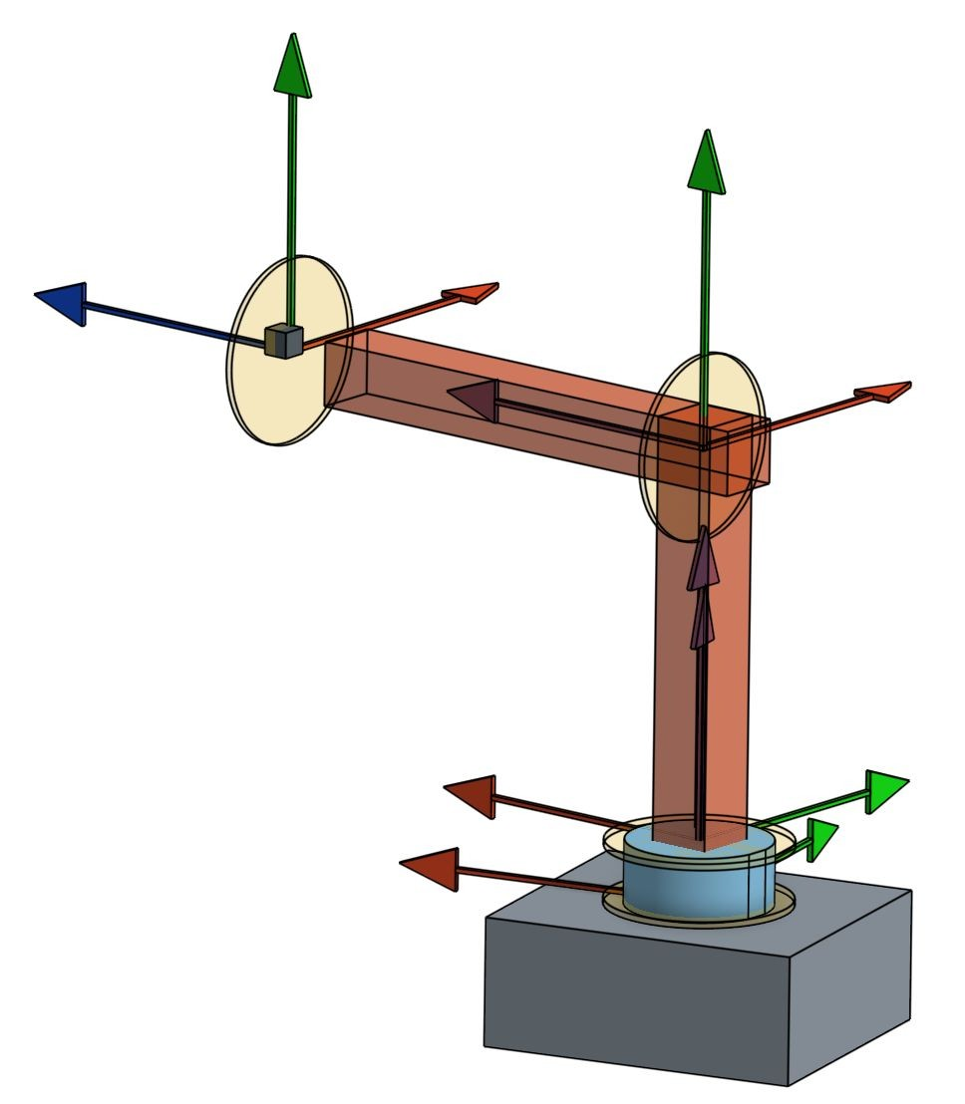
Inverse Position:
Cylindrical robot case
p_{c}
Robo1x-1.5

Slide 25
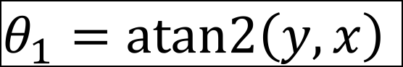
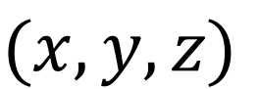
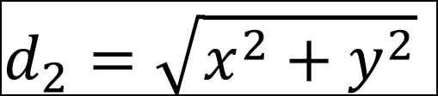
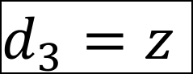
Cylindrical coordinates (RPP)
z
p_{c}
q₂ = d₂
q₃ = d₃
y
x
q₁= θ₁
Robo1x-1.5 25

Slide 26

Wrist Center Rotation
Robo1x-1.5 26

Slide 27
1st part of SCARA (RRP)
z
p_{c}
q₃ = d₃ q₁ = θ₁
x
y
q₂ = θ₂
Robo1x-1.5 27

Slide 28


Inverse Position Spherical Configuration (RRP)
Robo1x-1.6 28

Slide 29




Spherical Coordinates
θ Polar angle
(x,y,z)
r Radius
φ Azimuth angle
Robo1x-1.6

Slide 30

Inv. Pos. Spherical (RRP)
θ₂
d₃
θ₁
Robo1x-1.6

Slide 31






Inv. Pos. Spherical (RRP)
Robo1x-1.6 31
P

Slide 32


Inv. Pos. Articulated (RRR)
Robo1x-1.6

Slide 33

Inv. Pos. Articulated (RRR)
[insert videos here running next To each other simultaneously]
Robo1x-1.6

Slide 34



Inv. Pos. Articulated (RRR)
θ
2
d
3
θ
1
Robo1x-1.6

Slide 35


Inv. Pos. Articulated (RRR)
a₂
θ ₃
θ₂
a₃
P
Robo1x-1.6

Slide 36
Robotics: Fundamentals
Prof. Mark Yim University of Pennsylvania
Week 6: Spherical Wrist and Inverse Orientation
Robo1x-1.5

Slide 37


Sequential Rotations
θ
φ
ψ
By Euler2.gif: Juansemperederivative work: Xavax - This file was derived from Euler2.gif:, CC BY-SA 3.0,
By Juansempere - Own work, GFDL,
Robo1x-1.6

Slide 38



Euler Angle Rotation
z
y
x
Robo1x-1.6

Slide 39


Roll Pitch Yaw Rotation
z
Roll
y
x
Yaw
Pitch
Robo1x-1.6

Slide 40

12 possible orderings
CCA https://en.wikipedia.org/wiki/Euler_angles#Tait.E2.80.93Bryan_angles
Robo1x-1.6
40

Slide 41

Euler Angle Rotation
z
y
x
Robo1x-1.6

Slide 42


Euler Angle vs Spherical Wrist
Robo1x-1.6

Slide 43






Inverse Orientation (ZYZ)
Robo1x-1.6

Slide 44

Euler Angle Rotation
Robo1x-1.6

Slide 45


Euler Angle Rotation
Robo1x-1.6

Slide 46







Spherical Wrist (ZYZ)
Two solutions
Robo1x-1.6

Slide 47


Inverse Pos. + Ori. For P_{c}
Robo1x-1.6

Slide 48





Offset from P_{c} wrist center
P_{c}
P
Robo1x-1.6

Slide 49



Offset from P_{c} wrist center
Robo1x-1.6

Slide 50





Offset from P_{c} wrist center
Robo1x-1.6
50

Slide 51
Offset from P_{c} wrist center
Robo1x-1.6

Slide 52





Inverse Orientation
Spherical Wrist solution for R?
Robo1x-1.6

Slide 53





Inverse Orientation
Robo1x-1.6

Slide 54


Inverse Orientation
Robo1x-1.6

Slide 55




Inverse Orientation
Robo1x-1.6

Slide 56




IK for Cylindrical RPP
2 soln
2 soln
Robo1x-1.6

Slide 57
Robotics: Fundamentals
Prof. Mark Yim University of Pennsylvania
Week 6: Multiple Inverse Kinematic Solutions
Robo1x-1.5

Slide 58
Special cases
Multiple solutions
Gimbal lock
Representation singularity
Joint singularity
Dextrous workspace
Robo1x-1.6

Slide 59


Two solutions
θ₃
a₂
a
P
P
θ
3
2
θ₂
a₃
θ₃
a₂
Positive θ₃
Negative θ₃
Robo1x-1.6

Slide 60




Four Solutions to 6R robot
Right up
Left up
Robo1x-1.6 60
Right down
Left down

Slide 61





Wrist multiple solution
1st solution
2nd solution
Robo1x-1.6 61

Slide 62

Eight Solutions for 6R
x2
x2
x2
x2
Robo1x-1.6

Slide 63









Infinite solutions
Two Solutions
Robo1x-1.6

Slide 64

Elbow Solutions
θ₃
a₃
a
2
θ'₂
a₂
_{a3} P
-θ₃
Negative θ₃
θ₂
P
Positive θ₃
Robo1x-1.6

